Slide 1
Understanding Image Scenes And Videos By Scene Graph Generation
Moru Sai Tirupathi
2021ITB086
Somireddy Naveen Kumar Reddy
2021ITB085
Randhi Nagasurya
2021ITB015

Slide 2
Table Of Contents
01
02
03
04
What can be learnt from an image
Visual Scene Understanding
Dataset
Model Architecture
05
06
07
08
Scene Graph Generation
Metrics and Results
Future Scope And Applications
Discussion and Outro

Slide 3
01
What can be Learnt from an Image?

Slide 4
Various vision language Tasks
Vision-Language Integration
Importance of 2D vision tasks
Project scope – Analyze, Describe and Retrieve Meaningful Information
Task | Subtasks
Image Captioning | Retrieval-based, Template-based, Deep Learning-based
Visual Question Answering | Standard VQA, Knowledge-based VQA, Text VQA
Image Retrieval | Content-based, Sketch-based, Text-based, Semantic, Annotation-based

Slide 5
Progression of Image Understanding
Stage | Key Focus
Early Image Understanding | Low-level features (edges, textures)
Object Recognition | Detection of individual objects
Scene Understanding | Representation of object relationships and context

Slide 6
What is the best way to Analyze, Retrieve and Represent?
“
”

Slide 7
02
Visual Scene Understanding

Slide 8
Computer Vision Was Focused on DISCONNECTED OBJECTS
Visual scene understanding has traditionally focused on identifying Objects and images in OBJECT-Centric Techniques
Image Classification
Object Segmentation
Instance Segmentation

Slide 9
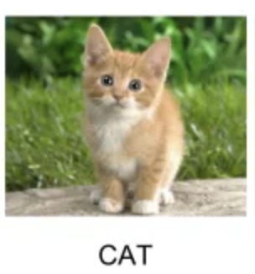
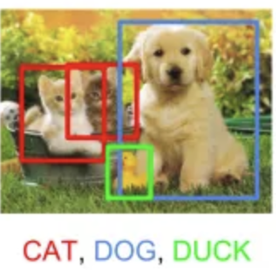
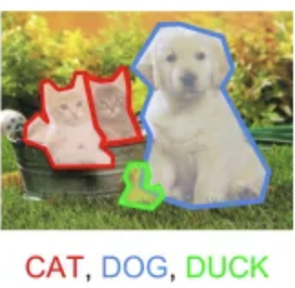
Object Centric Techniques
Classification
Object Detection
Instance
Segmentation
Presence
Spatial Extent
Pixel Wise Spatial Extent
https://medium.com/swlh/object-detection-and-instance-segmentation-a-detailed-overview-94ca109274f2z

Slide 10
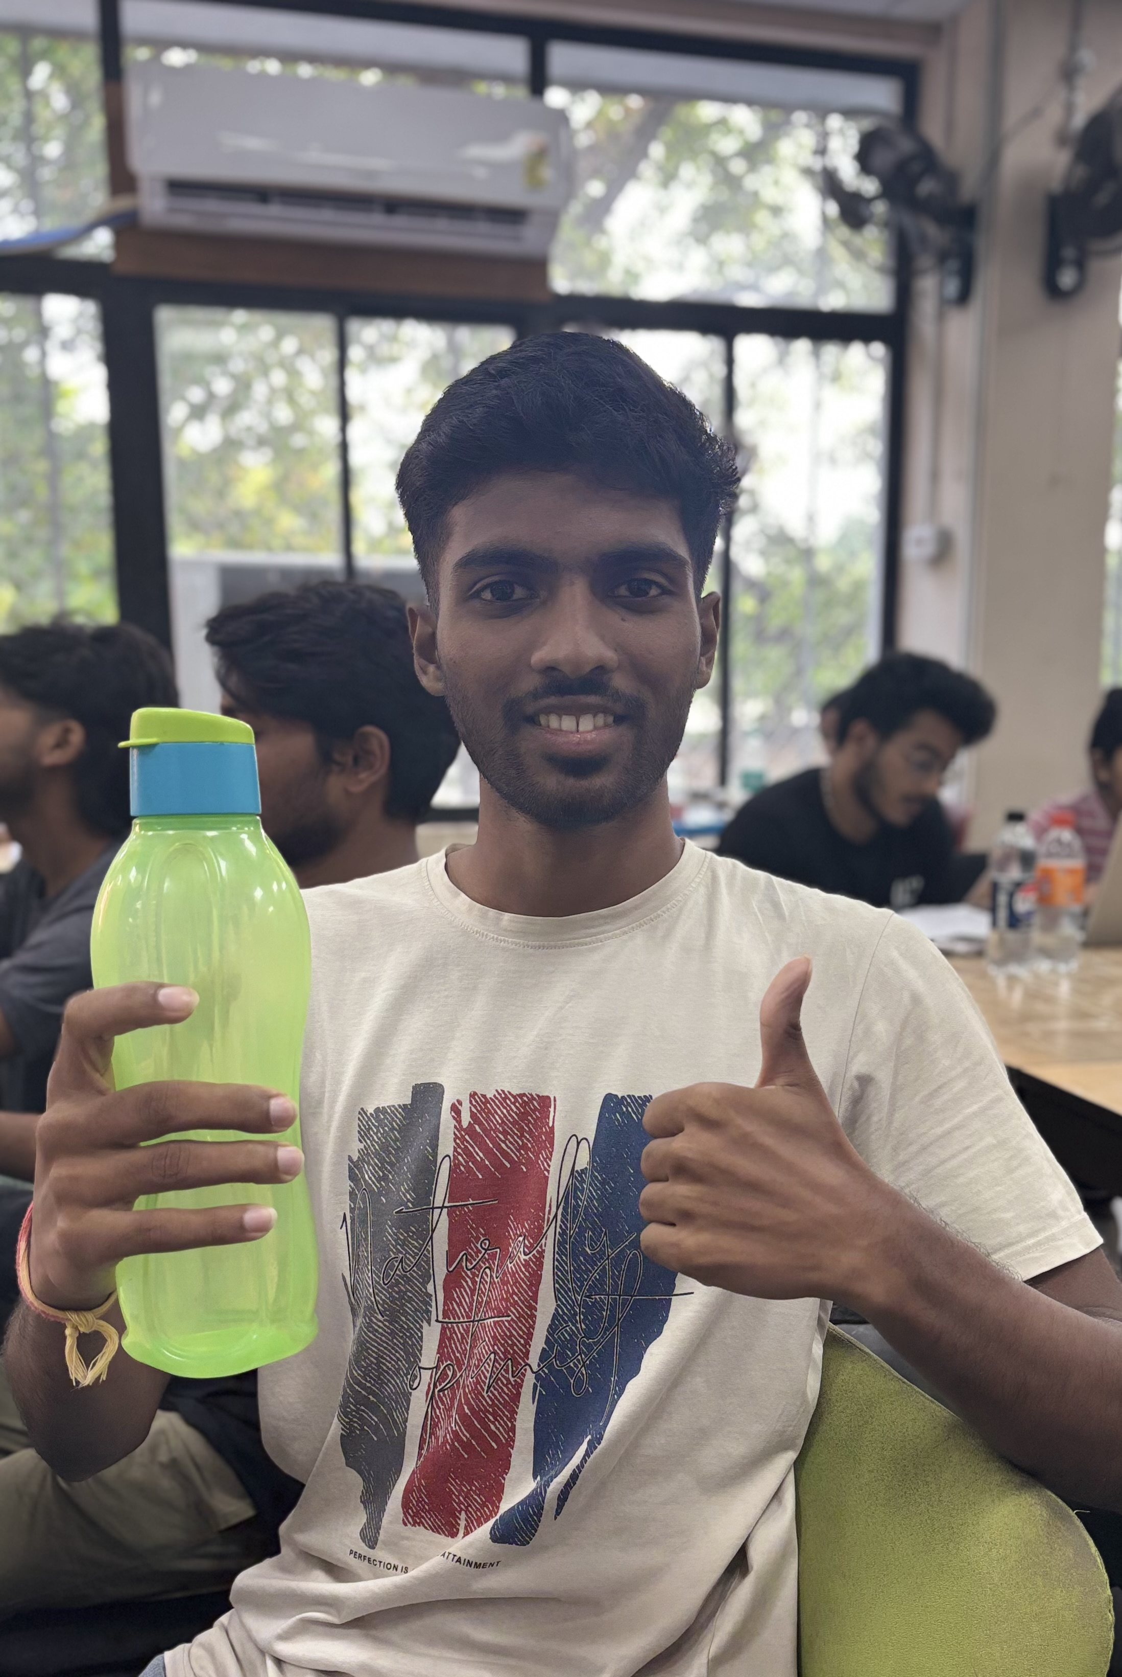
However, Representing scenes as collection of objects fails to capture RELATIONSHIPS which is essential for scene understanding.
Holding, On chair

Slide 11
What Info Does Language Capture?
Objects – Things present in scene
Attributes – Properties of objects
Relationships – How objects are connected relative to one another

Slide 12
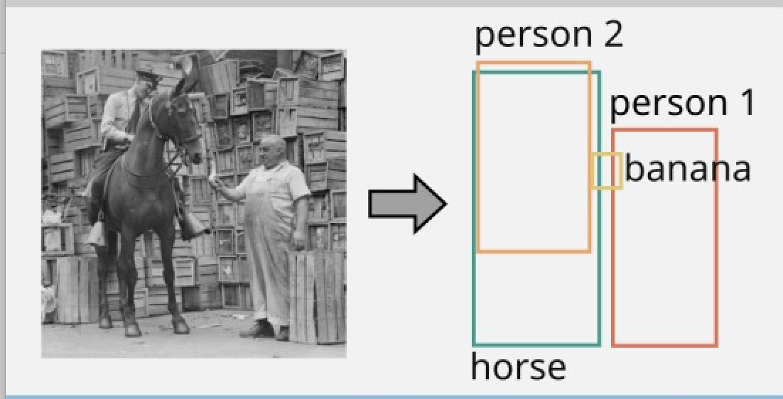
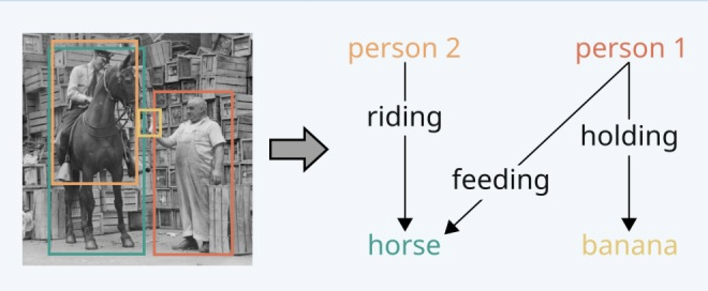
Then Comes Scene Graph!
Scene graphs represent images as nodes (objects) and edges (relationships).
They capture both objects and their interactions for deeper understanding.
Examples include "a person riding on a horse" or "a person feeding a horse"

Slide 13
03
Dataset

Slide 14

DATASET
Panoptic Scene Graph (PSG) dataset is a large-scale, richly annotated dataset that unifies scene graph generation with object segmentation.
It includes:
•⁠ Images and Scene Graphs
•⁠ ⁠Objects with panoptic segmentation
•⁠ ⁠Relationships
•⁠ ⁠Triplets
*

Slide 15
Contents of Dataset
Images
Object classes
Predicate Classes
49,000+ (combined
images from Visual
Genome and COCO)
133 (80 objects like
animal, vehicles etc.
and 53 stuff like sky,
Road, grass etc)
56 classes split between
spatial(on, in),
functional(used for, made of),
action based(riding, holding),
Existential( attatched to, part of).
Triplets
<Subject, Predicate, Object>

Slide 16
Component | Description | Average per Image
Objects | Instances with panoptic segmentation and category labels | ~15
Relationships | Annotated pairwise relations among segmented objects | ~10–20
Triplets | <subject, predicate, object> entries, each grounded in segmentation masks | ~18
Panoptic Masks | Per-pixel segmentation of all object and background categories | Full image
Scene Graphs | Graph representation of objects and their relationships | 1

Slide 17
04
Model Architecture

Slide 18
Model Architecture
Step 1: YOLO Backbone – CSPNet
Purpose: Extract hierarchical features from the input image.
Architecture Used: CSPNet (Cross Stage Partial Network).
Layers:
C1–C5: Each successive layer extracts features at increasing levels of abstraction and decreasing spatial resolution.
C1, C2 : Low-level features (edges, colors) - 320×320×64, 160×160×128
C3, C4 : Mid-level features (object parts) - 80×80×256 , 40×40×512
C5 : High-level features (full objects, semantics) - 20×20×1024

Slide 19
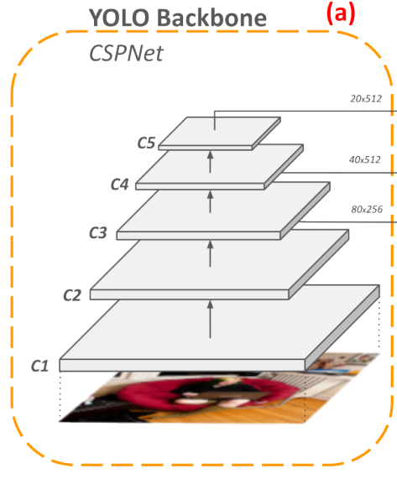
Khanam, R., & Hussain, M. (2024). What is YOLOv5: A deep look into the internal features of the popular object detector. arXiv preprint arXiv:2407.20892. https://arxiv.org/abs/2407.20892

Slide 20
Step 2: YOLO Neck – PAN-FPN
Purpose: Fuse features across different scales from the backbone.
Architecture Used: Path Aggregation Network combined with Feature Pyramid Network.
Layers Output: P3, P4, P5 correspond to feature maps at resolutions:
P3 → 80×80×256
P4 → 40×40×512
P5 → 20×20×1024
Why PAN-FPN?
Combines low-level (fine-grained) and high-level (semantic) features.
Helps in detecting small, medium, and large objects.

Slide 21
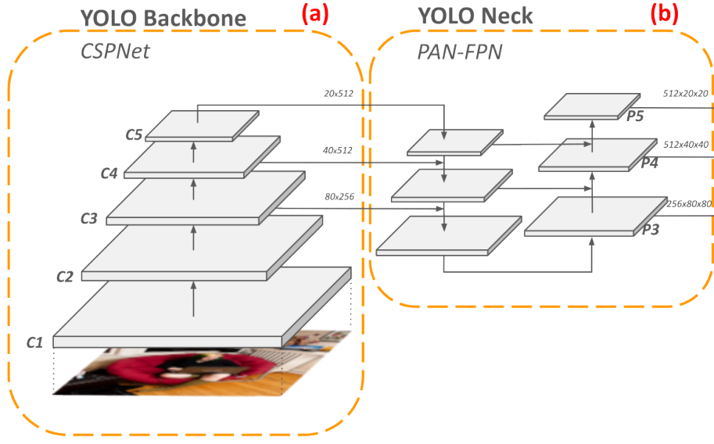
Khanam, R., & Hussain, M. (2024). What is YOLOv5: A deep look into the internal features of the popular object detector. arXiv preprint arXiv:2407.20892. https://arxiv.org/abs/2407.20892

Slide 22
Step 3: YOLO Detection Head
Purpose: Perform dense object detection directly on PAN-FPN outputs.
Functionality: Outputs: Bounding box coordinates. Objectness score (confidence of object presence). Class probabilities.
Why YOLO Head? Fully convolutional and fast.
Step 4: Non-Maximum Suppression (NMS)
Purpose: Filter overlapping bounding boxes to retain the best ones.
Why apply NMS here?
Keeps only a manageable number of high-quality proposals. Critical for reducing computational cost in the second stage (relation prediction).

Slide 23
Step 5: Spatial Feature Extraction
Purpose: Compute spatial encoding of each bounding box.
Components:
Input: Box coordinates.
Output: Encoded spatial features (e.g., normalized positions, aspect ratios).
Role in SGG: Spatial layout helps infer relationships (e.g., “on”, “under”, “next to”).
Step 6: Visual Feature Extraction - Region Of Interest (ROI) Align
Purpose: Extract object-aligned visual features from feature maps.
Steps : 1. Divide into Bins
2.Process each bin so that the result is precisely aligned fixed size feature maps.
Output: Fixed-size visual feature maps for each proposal.

Slide 24
Image YOLO
Spatial Feature Extraction
ROI Align
Spatial features
Object classes
Visual features

Slide 25
Relation Prediction in Scene Graph Generation
Generate All Possible Subject-Object Pairs:
Output: All ordered pairs
P={(s,o)∣s,o∈O,s≠o}
For N objects, ∣P∣=N×(N−1)∣P∣=N×(N−1) pairs.

Slide 26
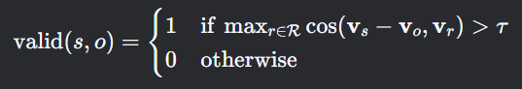
Filter Pairs with GloVe (Semantic Prior):
Rule: Reject pairs where subject→object is semantically invalid
vs​,vo ​: GloVe embeddings for subject/object classes.
vr ​: GloVe embeddings for relationships.
τ: Threshold

Slide 27
Feature Fusion:
To predict relations, we build a feature vector that combines information from the subject, the object, and their spatial configuration.
For each valid pair (s,o):
fs,o = [vs;vo;ϕ(s, o)]
vs,vo​ : GloVe embeddings for subject/object classes.
ϕ(s,o) : Spatial features (8D vector)

Slide 28
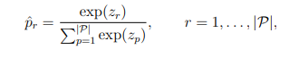
MLP Classifier and Soft-max Scoring :
The fused feature f is fed into a neural classifier (typically several fully-connected layers)
Network then applies a soft-max function to convert logits into a probability distribution over relation classes

Slide 29
P(r∣s,o)=softmax(W2​ReLU(W1​fs,o​+b1​)+b2​)
W1∈R(512×df)​, W2∈R(∣R∣×512)
df​: Fused feature dimension (e.g., 608 for GloVe-300 + spatial-8).

Slide 30
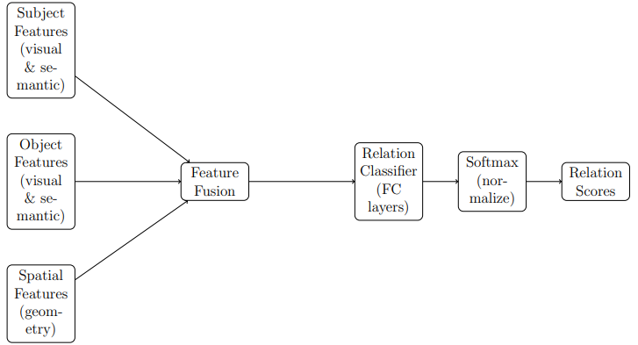

Slide 31
05
Scene Graph Generation

Slide 32
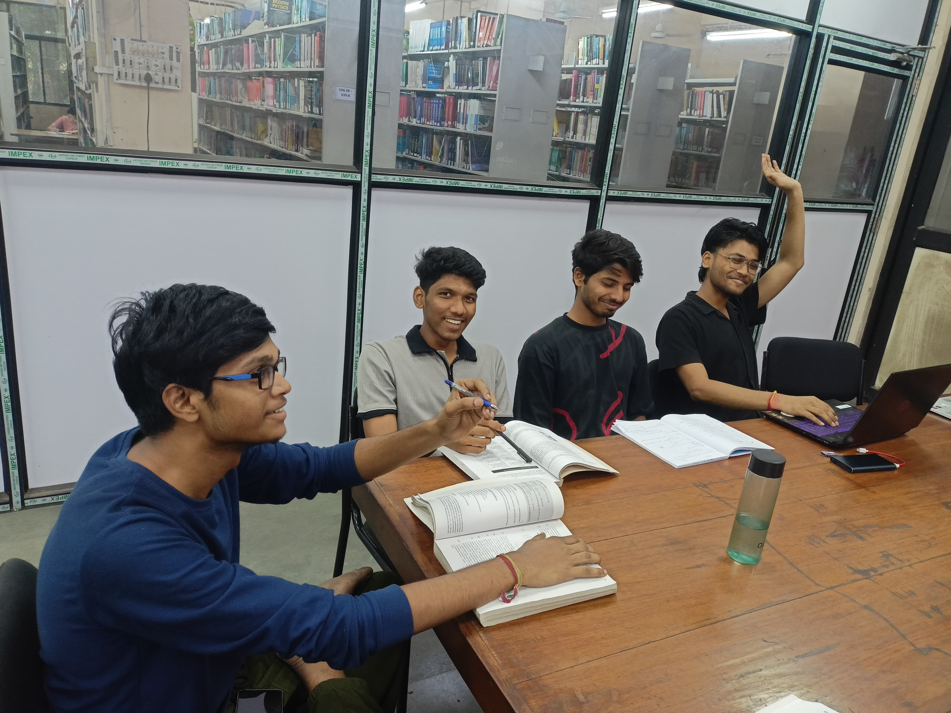
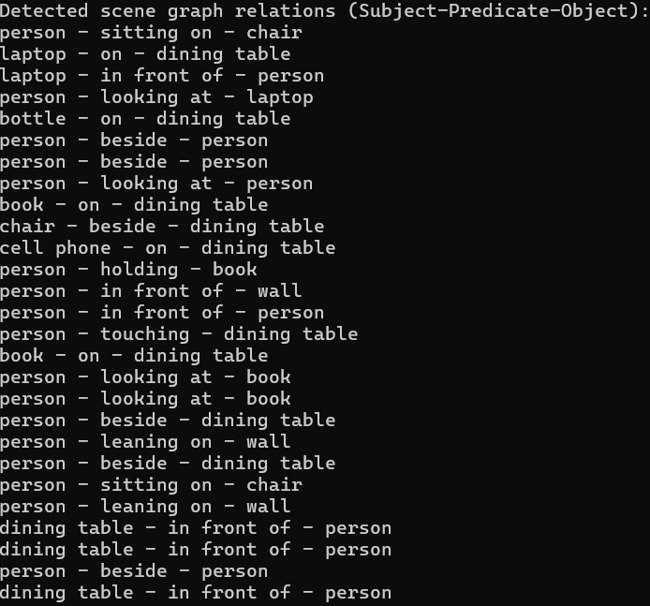
Sample Scene Graph From Image

Slide 33
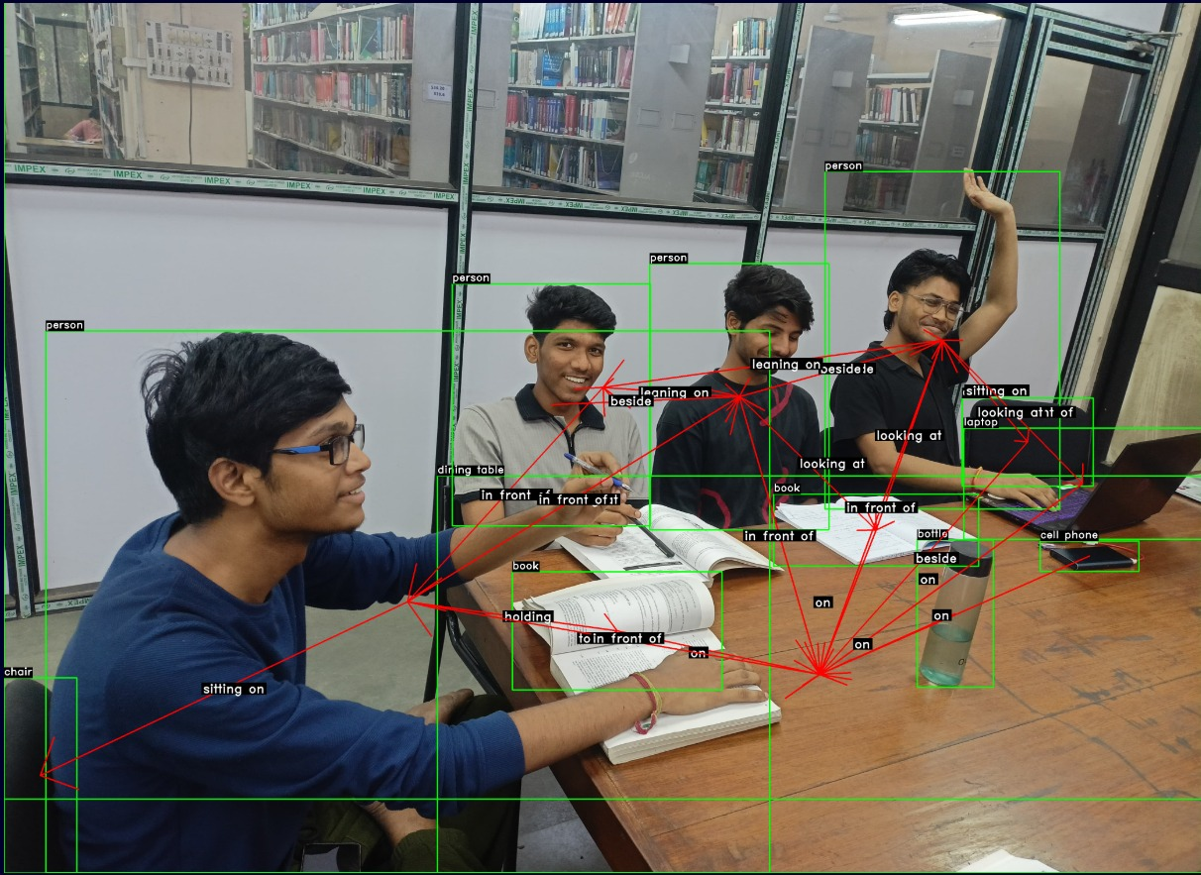

Slide 34
05
Metrics And Results

Slide 35
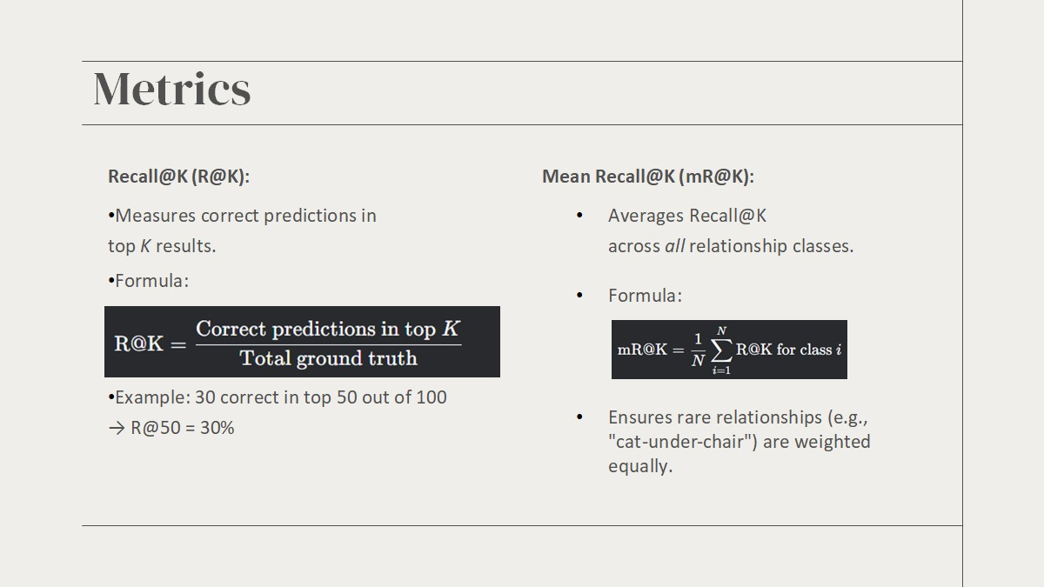

Slide 36
Results
Model | SGDet mR@50 | SGDet mR@100
Neural Motifs (Recurrent pattern modelling through global context) | 6.6 | 7.9
VCTree (Visual Context Tree : Contextual Importance and Visual Closeness) | 5.8 | 6.6
PE – NET (Prototype Based Embedding Network) | 16.7 | 18.8
Our Approach | 12.4 | 14.5
SGDet – Scene Graph Detection

Slide 37
07
Future Scope And Applications

Slide 38
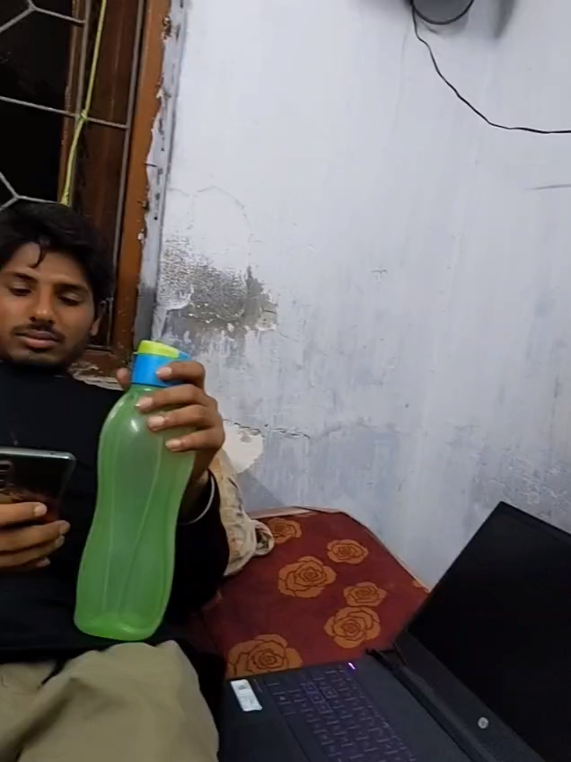

Slide 39
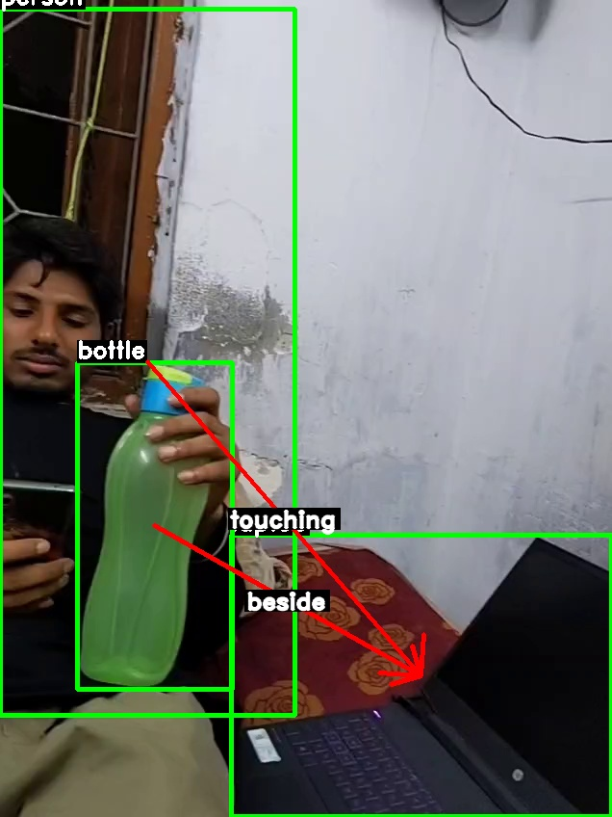
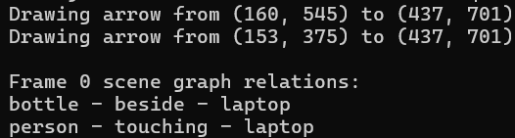

Slide 40
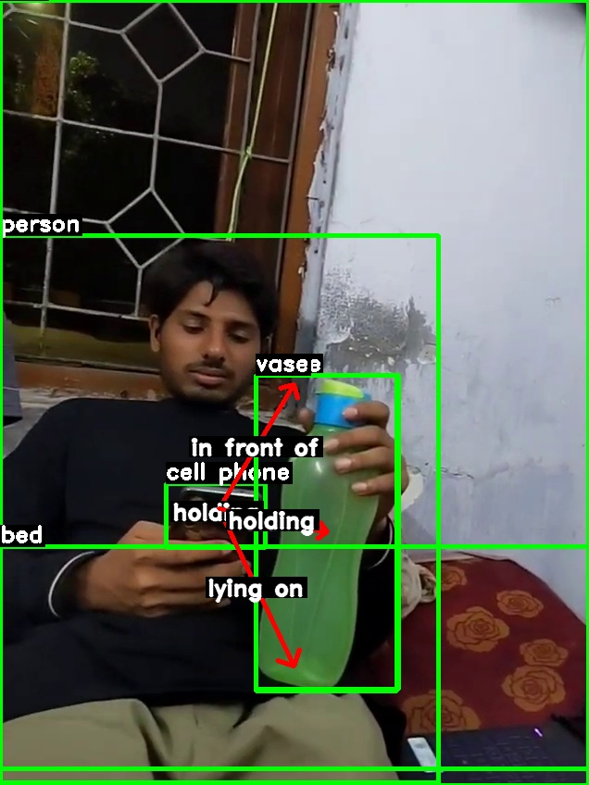
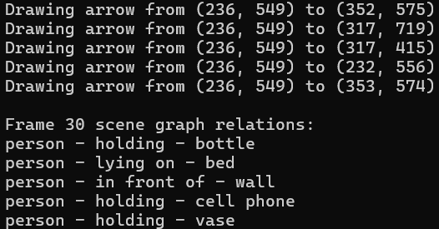

Slide 41
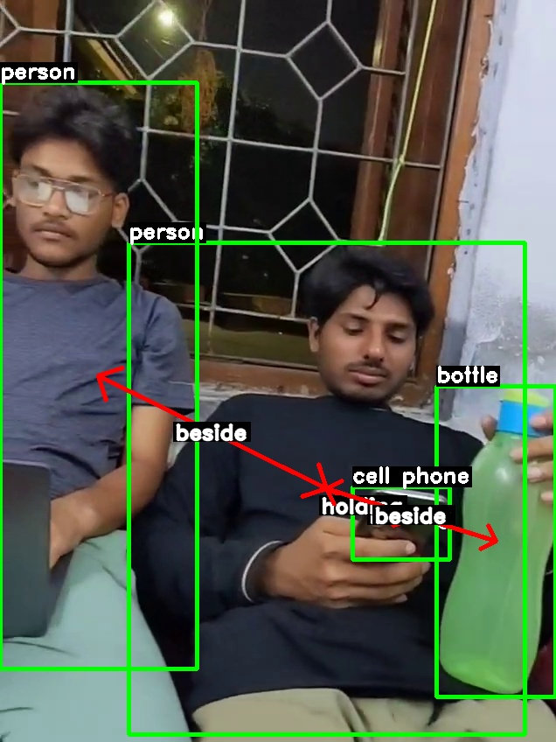
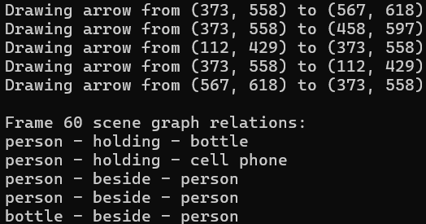

Slide 42
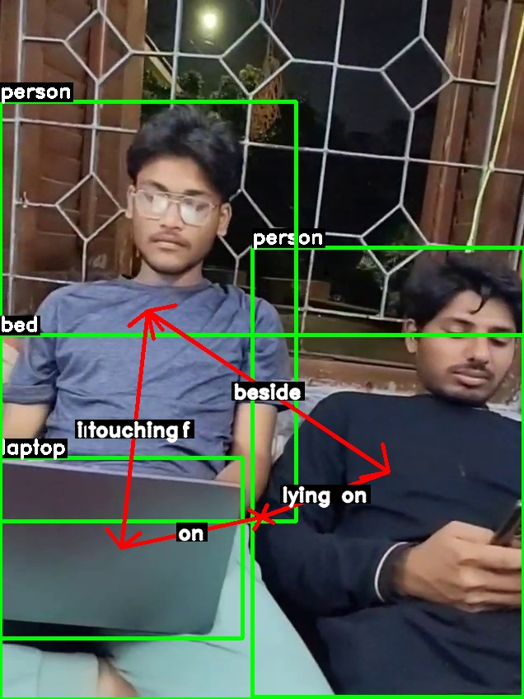
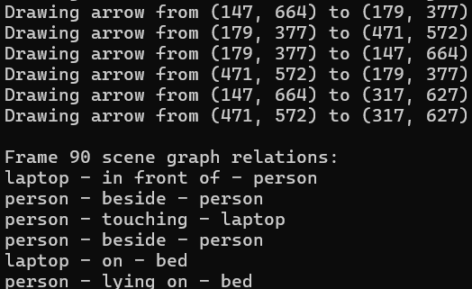

Slide 43
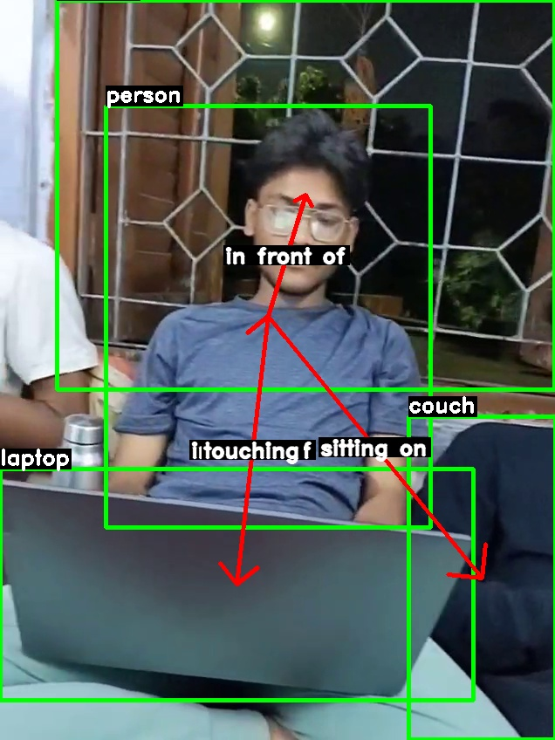
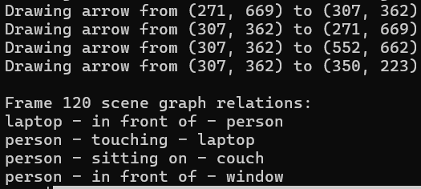

Slide 44
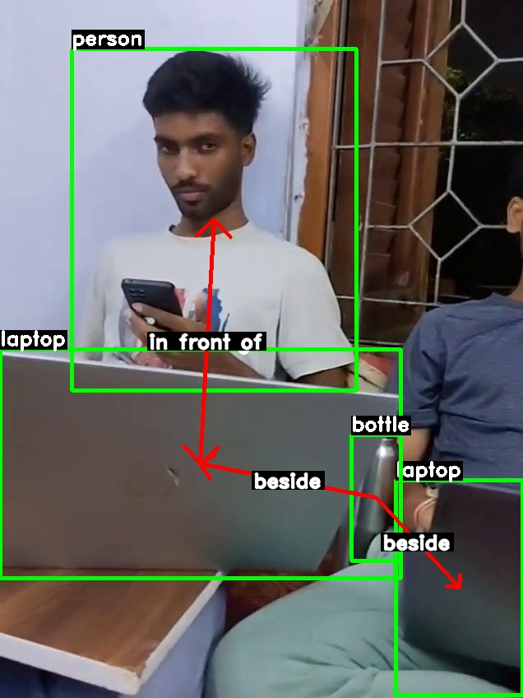
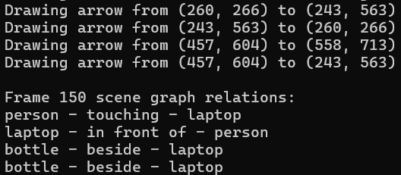

Slide 45
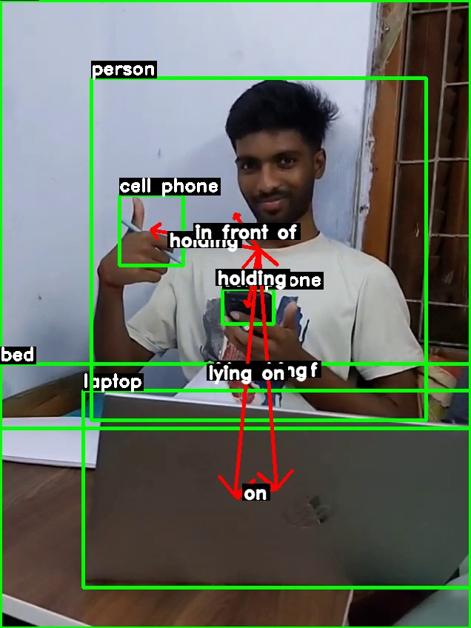
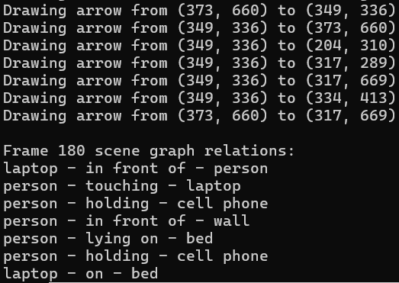

Slide 46
Future Scope And Application
Real-Time
Applications:
Person-Centric Action Recognition
Add modules for person re-identification and action recognition to describe what a specific person is doing (e.g., "Person X is walking" or "picking up an object").
Enable real-time,
dynamic activity recognition
for use in surveillance, smart
analytics, and personalized
monitoring.

Slide 47
Thank You

